Slide 1
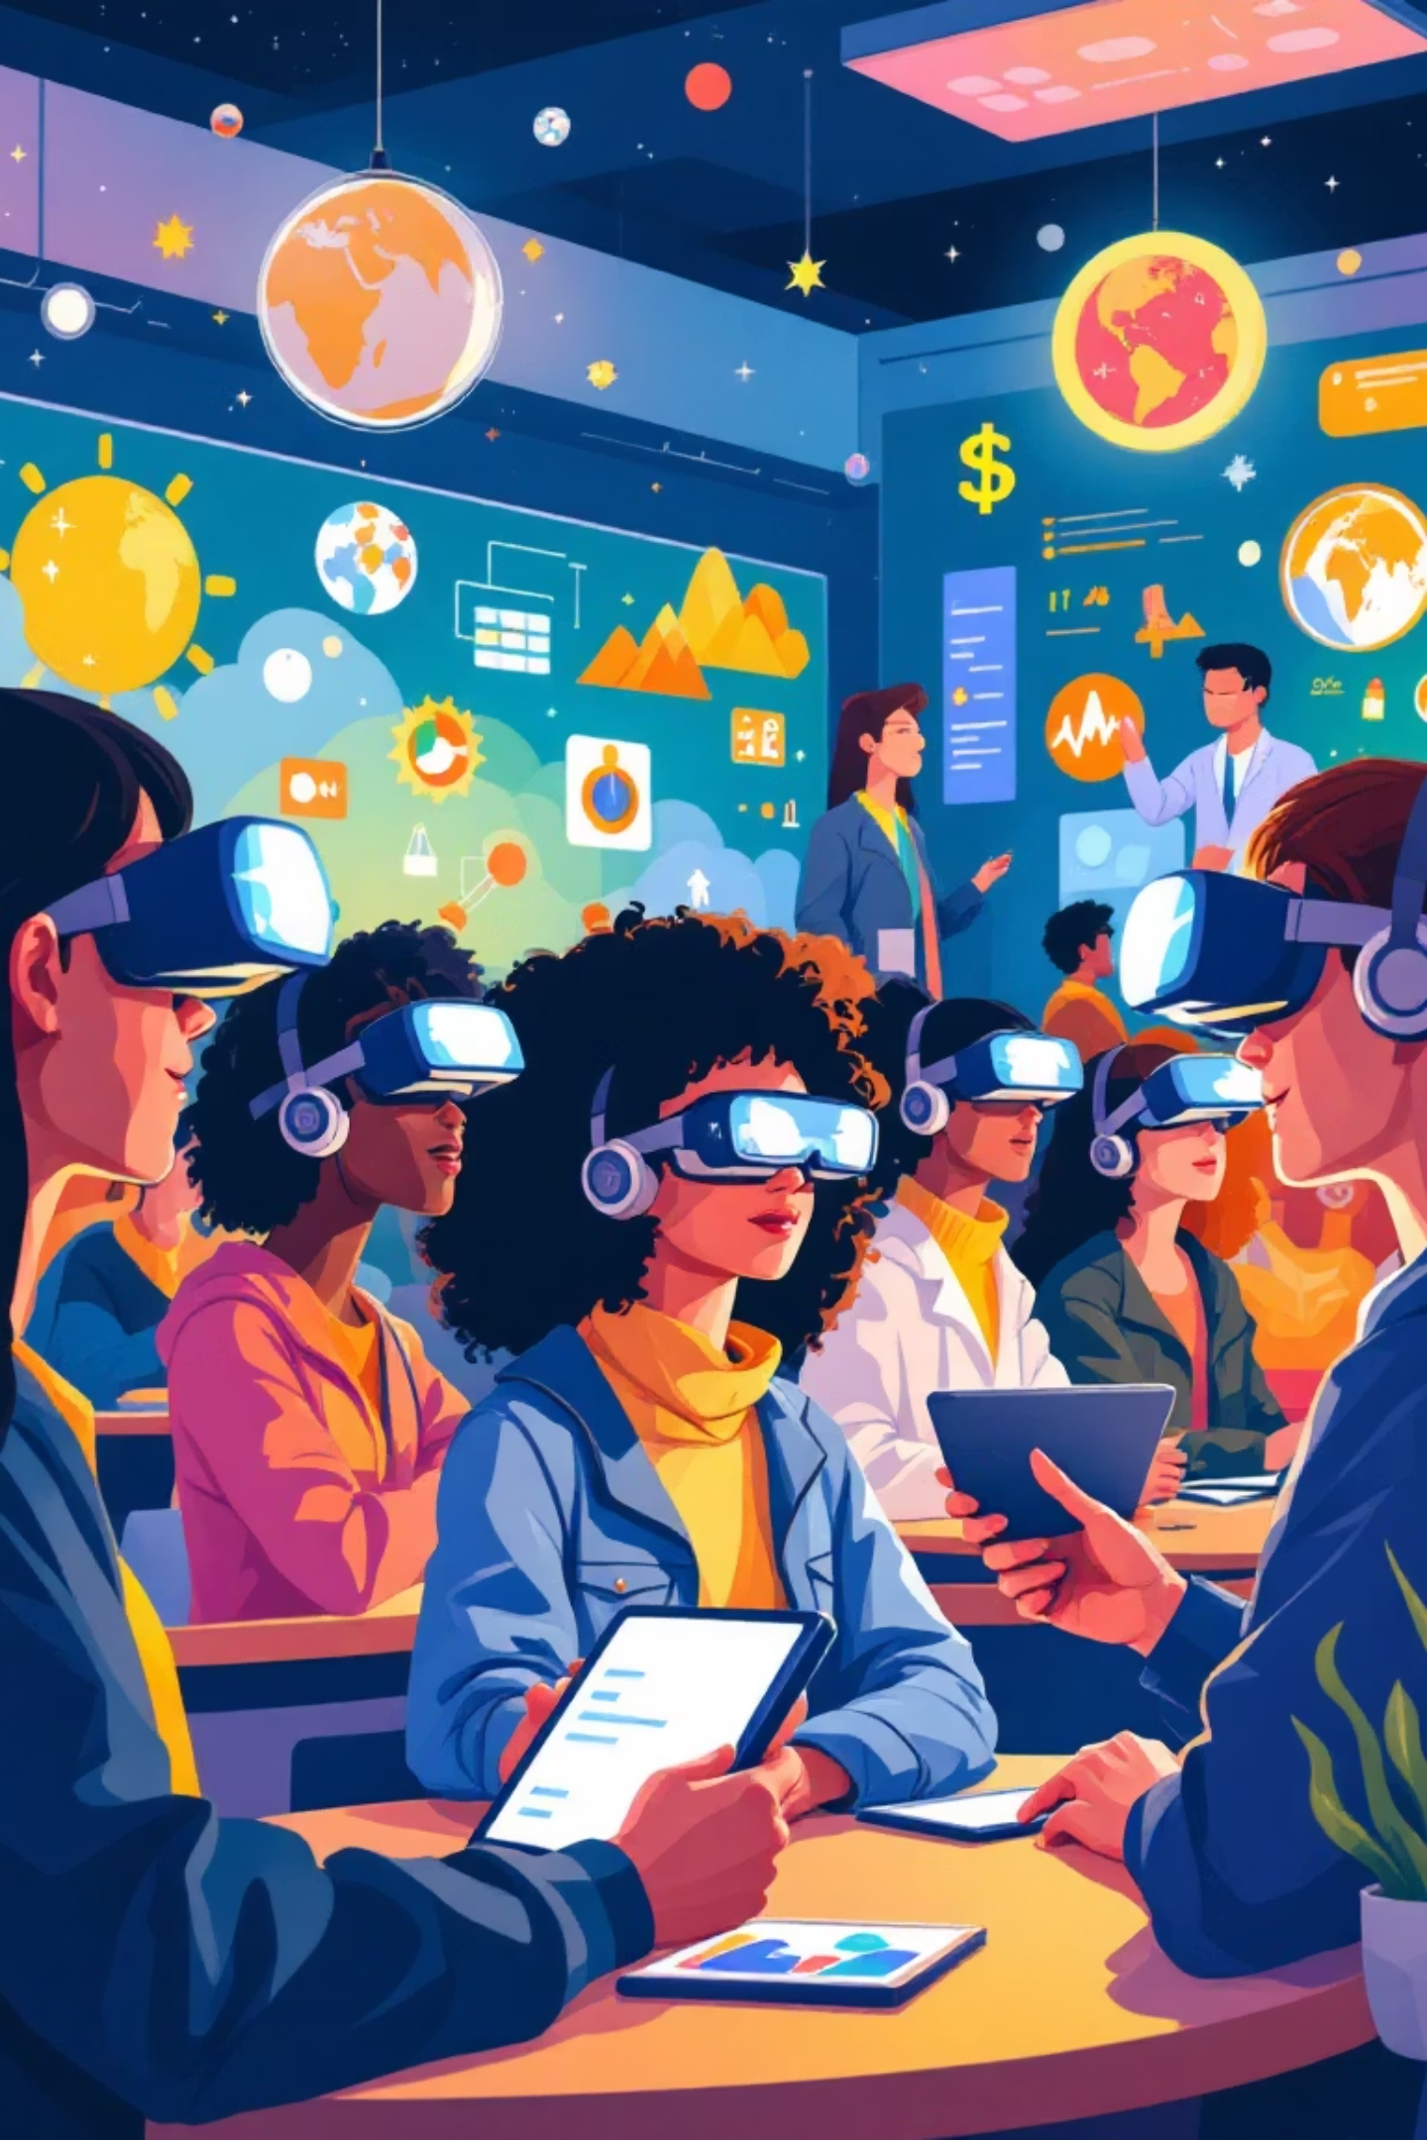
Transforming Science Education with Digital Innovation
Exploring Khan Academy, VR Glasses, Brain Space, Flashcards, and Naturalist Applications

Slide 2


DIGITAL LEARNING PLATFORM
What is Khan Academy?
Khan Academy is a revolutionary free online learning platform founded by Salman Khan in 2008. It has transformed education by making world-class instruction accessible to everyone, anywhere.
The platform offers personalized science lessons complete with engaging video tutorials, interactive exercises, and comprehensive progress tracking tools. Today, millions of students and teachers worldwide rely on Khan Academy to deepen understanding and master challenging concepts.

Slide 3
Khan Academy in Science Education
Comprehensive Coverage
Self-Paced Learning
Teacher Insights
Expert-created content spans biology, chemistry, physics, and earth sciences with detailed explanations and real-world applications
Students learn at their own speed, revisiting challenging topics and advancing quickly through familiar material to fill knowledge gaps
Interactive dashboards provide real-time data, enabling educators to tailor instruction and monitor individual student progress effectively

Slide 4
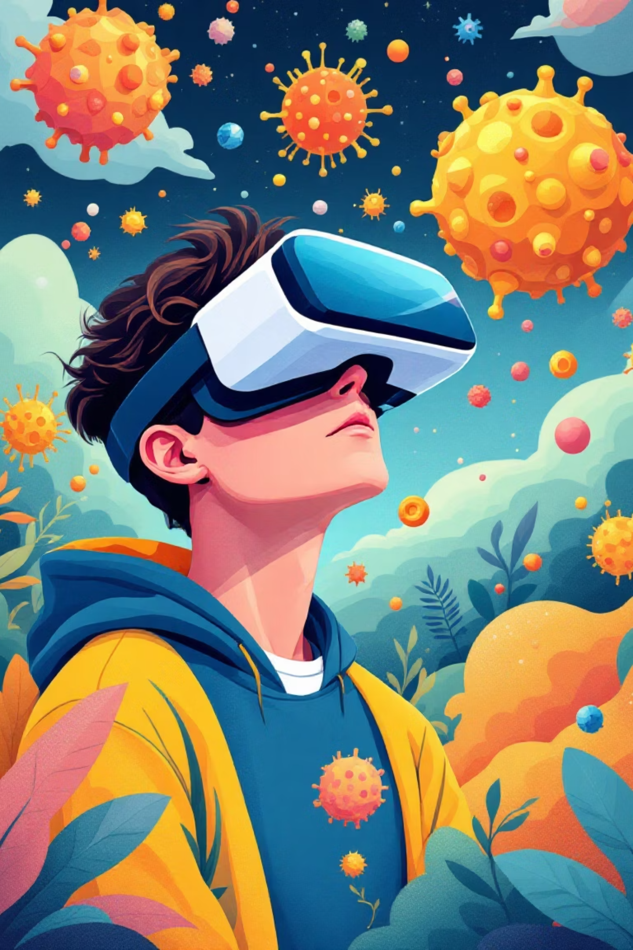
VR Glasses: Immersive Learning in Science
Virtual Reality technology creates stunning 3D environments that bring complex scientific concepts to life. Students can take extraordinary virtual field trips—from journeying through the solar system to exploring the intricate inner workings of a living cell.
This immersive approach dramatically increases engagement and makes abstract ideas tangible. Visualizing molecular structures, chemical reactions, or geological formations in three dimensions transforms how students understand and retain scientific knowledge.

Slide 5
Brain Space: Enhancing Cognitive Skills
Cognitive Training
Science Learning Support
Brain Space applications focus on strengthening essential mental skills including memory, attention span, and problem-solving abilities through targeted exercises.
By improving focus and information retention, these apps create a stronger foundation for mastering scientific concepts and complex theories.
Gamified Motivation
Interactive challenges and reward systems keep students engaged while developing critical scientific thinking and analytical reasoning skills.

Slide 6
MEMORY ENHANCEMENT
Flashcards: Active Recall for Science Facts
1
2
3
Digital Memorization
Spaced Repetition
Subject Versatility
Digital flashcard apps help students efficiently memorize essential terms, formulas, and scientific processes across all disciplines
Intelligent algorithms determine optimal review timing, maximizing long-term retention and minimizing study time
Widely used for anatomy, periodic table elements, scientific definitions, and complex terminology across science subjects

Slide 7

Naturalist Applications: Connecting Science to Nature
Real-World Discovery
Applications like iNaturalist empower students to become citizen scientists by identifying and documenting plants, animals, and ecosystems in their local environment.
Outdoor Learning
These tools encourage hands-on field work and authentic scientific observation, bridging the gap between textbook theory and living nature.
Biology Integration
Field experience deepens understanding of biodiversity, ecology, and conservation while making biology lessons personally relevant and memorable.

Slide 8

How These Tools Work Together in Science Lessons
VR Immersion
Khan Academy
Brain Space
Naturalist App
These complementary technologies create a powerful, multi-layered learning ecosystem. Khan Academy establishes foundational knowledge through structured lessons. VR glasses transform understanding through immersive, experiential exploration. Brain Space apps and flashcards reinforce cognitive skills and cement information in long-term memory. Finally, Naturalist applications bring everything full circle by connecting classroom learning with authentic environmental experiences.

Slide 9



SUCCESS STORIES
Real-World Impact: Case Studies
40%
20%
95%
Engagement Boost
Score Improvement
Interest Growth
Schools implementing VR technology report dramatically higher student engagement in science classes
Khan Academy users show average test score increases, demonstrating measurable academic gains
Naturalist app projects significantly increase student enthusiasm for ecology and conservation careers

Slide 10
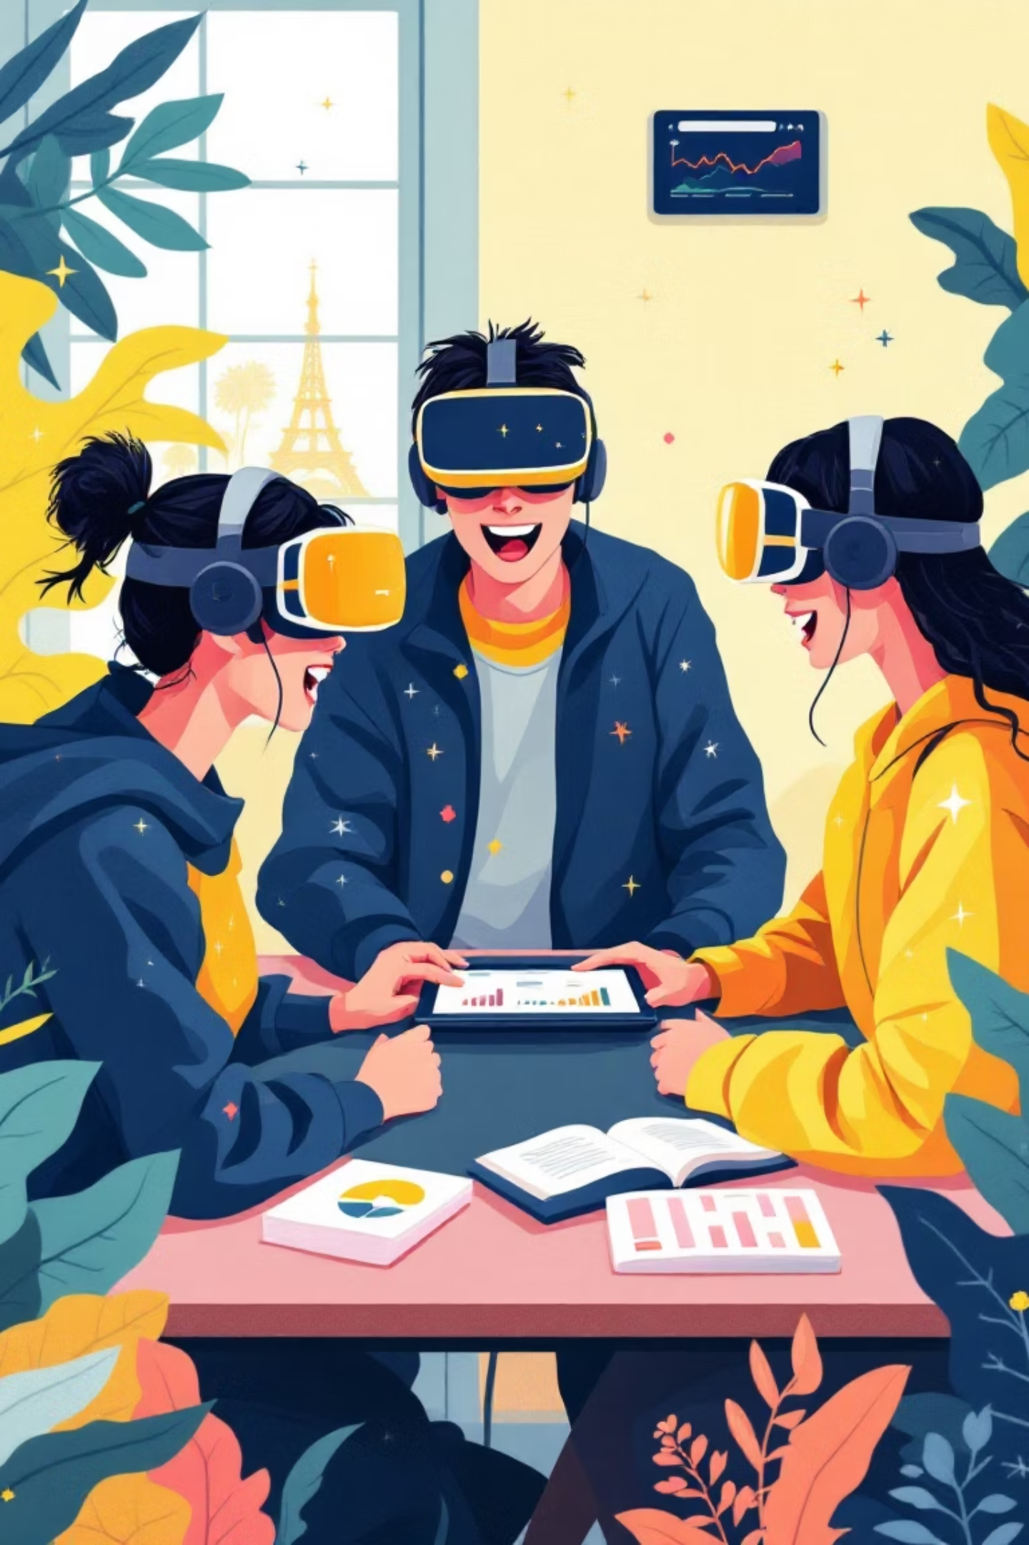
Conclusion: Transforming Science Education
Deeper Understanding
Active Learning
Future-Ready Education
Students become engaged participants, connecting directly with authentic science rather than passive observers
The future of science education is interactive, personalized, and deeply engaging for every learner
Combining digital platforms with immersive technology creates profound comprehension of scientific principles

